Slide 1
Multimodal, Multiresolution, Multivolume Data
Guido Gerig & Sungmin Hong
NYU Tandon School of Engineering, Computer Science & Engineering
Dr. Thomas Ach, University Hospital Würzburg, Dept. of Ophthalmology
Goal: Study/diagnosis of AMD (age-related macular disease)
Current data: RPE (retinal pigment epithelium) tissue from donors
Future data: In-vivo hyperspectral camera

Slide 2
Overview

Slide 3

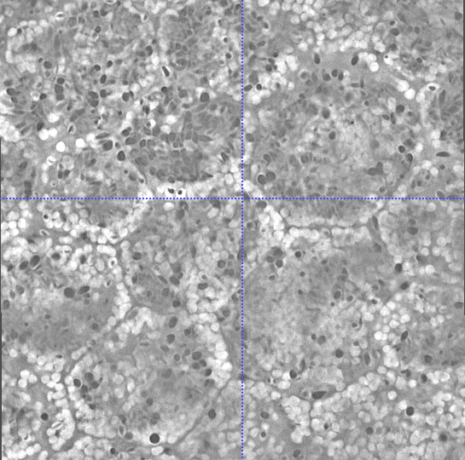
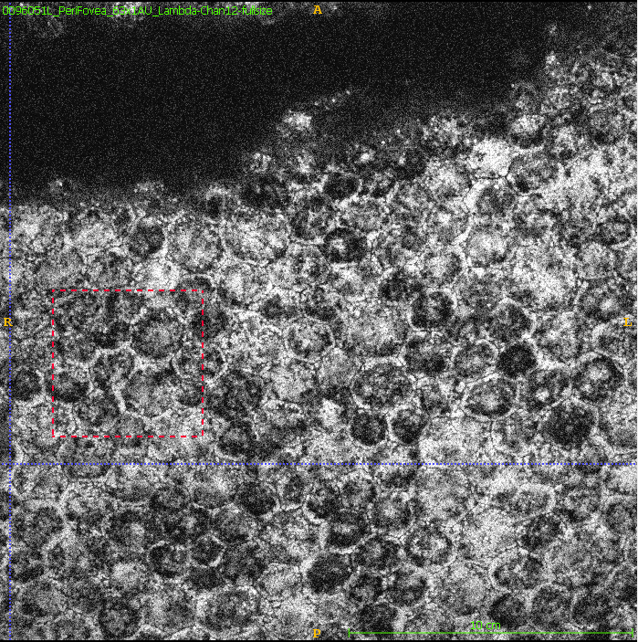


Input Data
SIM Data (488nm)
LSM Data (shown 597nm)
xy
xy
xz
xz
Multivolume across 24 emission wavelengths
yz
yz

Slide 4
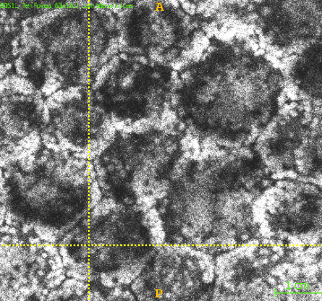
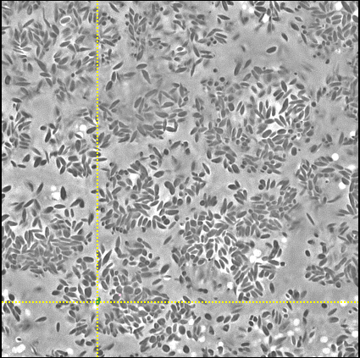
Structual/hyperspectral 3D Imaging
Goal: Autofluorescence spectra and intensity of individual granules
3D SIM
4D LSM
super-resolution structured illumination microscopy (SIM, Zeiss Elyra.S1)
λ
high-resolution confocal laser scanning spectral microscopy (Zeiss LSM780)

Slide 5
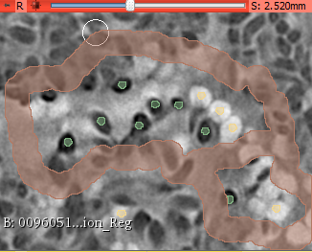
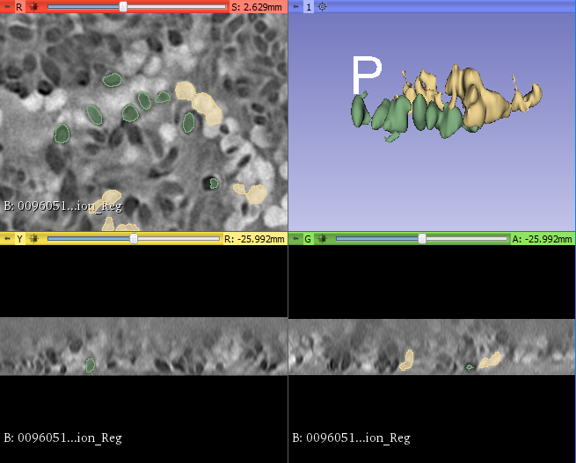
Segmentation of Organelles from SIM
3D Slicer GrowCut:
Segmentation of “dark” and “white” organelles

Slide 6
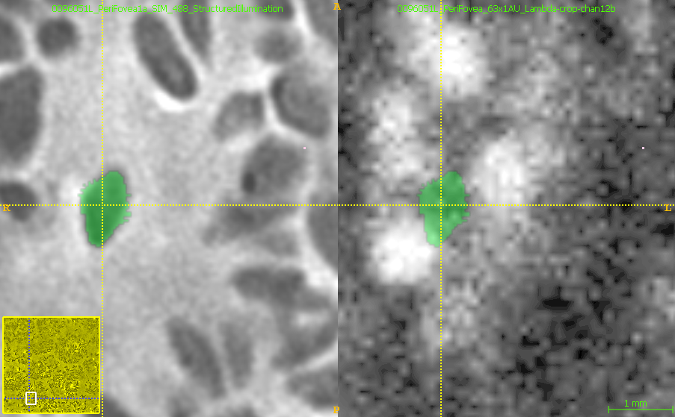
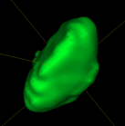
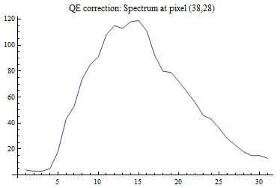
Autoflourescence Analysis of Granules
SIM
LSM
SIM
LSM
λ
3D granule
Spectrum per granule
3D/4D registration
3D segmentation
Multivolume quantitative analysis

Slide 7

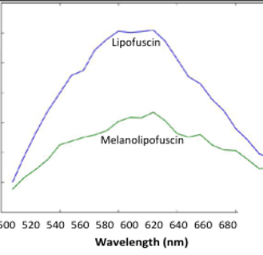
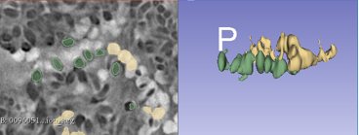
To be developed …
3D labels
4D multivolume
? so far external python script
? multivolume support for non-Dicom data

Slide 8
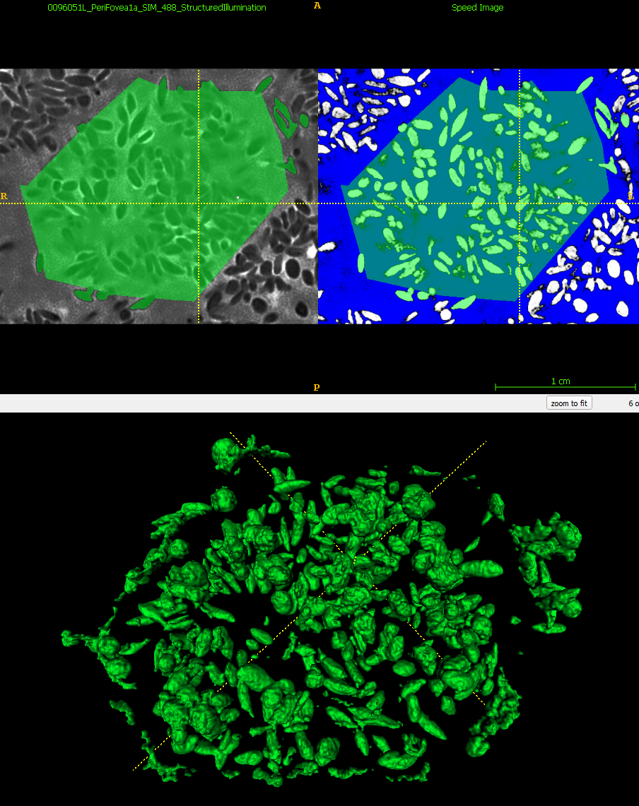
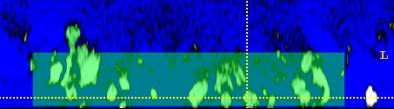
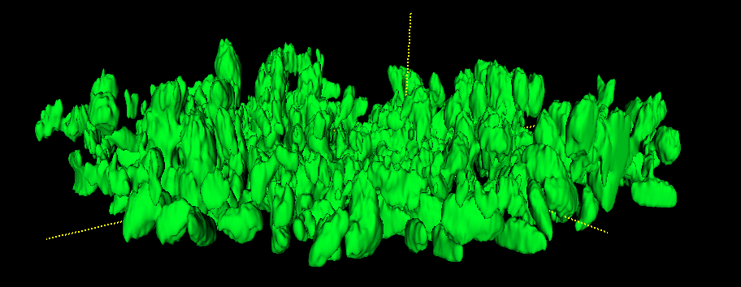
Work in Progress:
Research question: Spatial distribution of granules within the cell (granules/layer)
3D segmentation of granules within single cell

